Slide 1
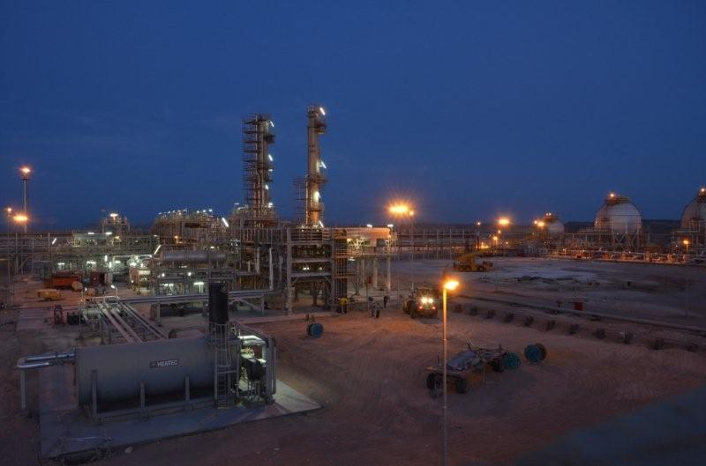
Egyptian Bahraini Gas Derivatives Co.

Slide 2




EBGDCO Share holders
EBGDCO company was establish in 2008
EGAS
40%
APICORP
20%
DANA GAS
40%

Slide 3
EBGDCO NGL Plant
Plant Designed to produce propane and butane
Plant located down stream Gupco plant in Suez Area 350 Km far from Cairo
Plant started construction phase on Mid of 2010
Plant started up on August 2012
Project cost was $125 Million
First Cargo was shipped 1st October 2012

Slide 4
Movie shown EBGDCO project progress cycle

Slide 5
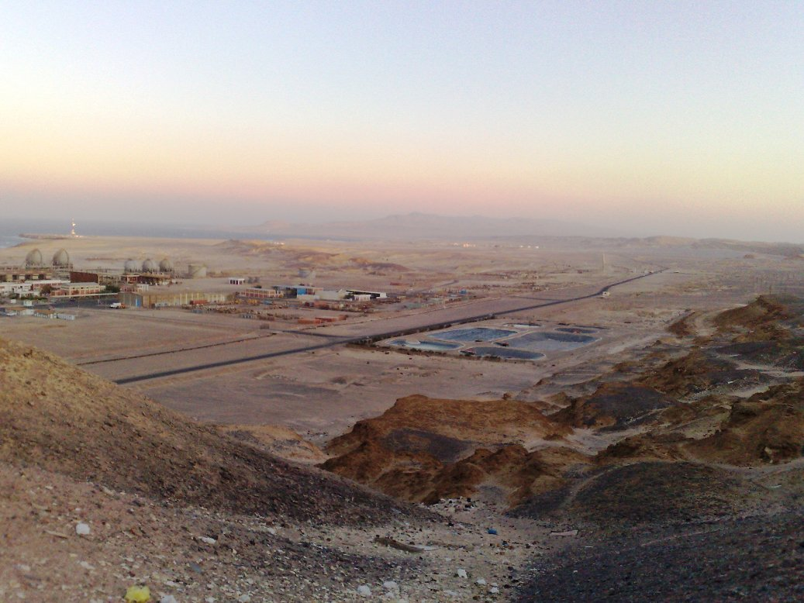
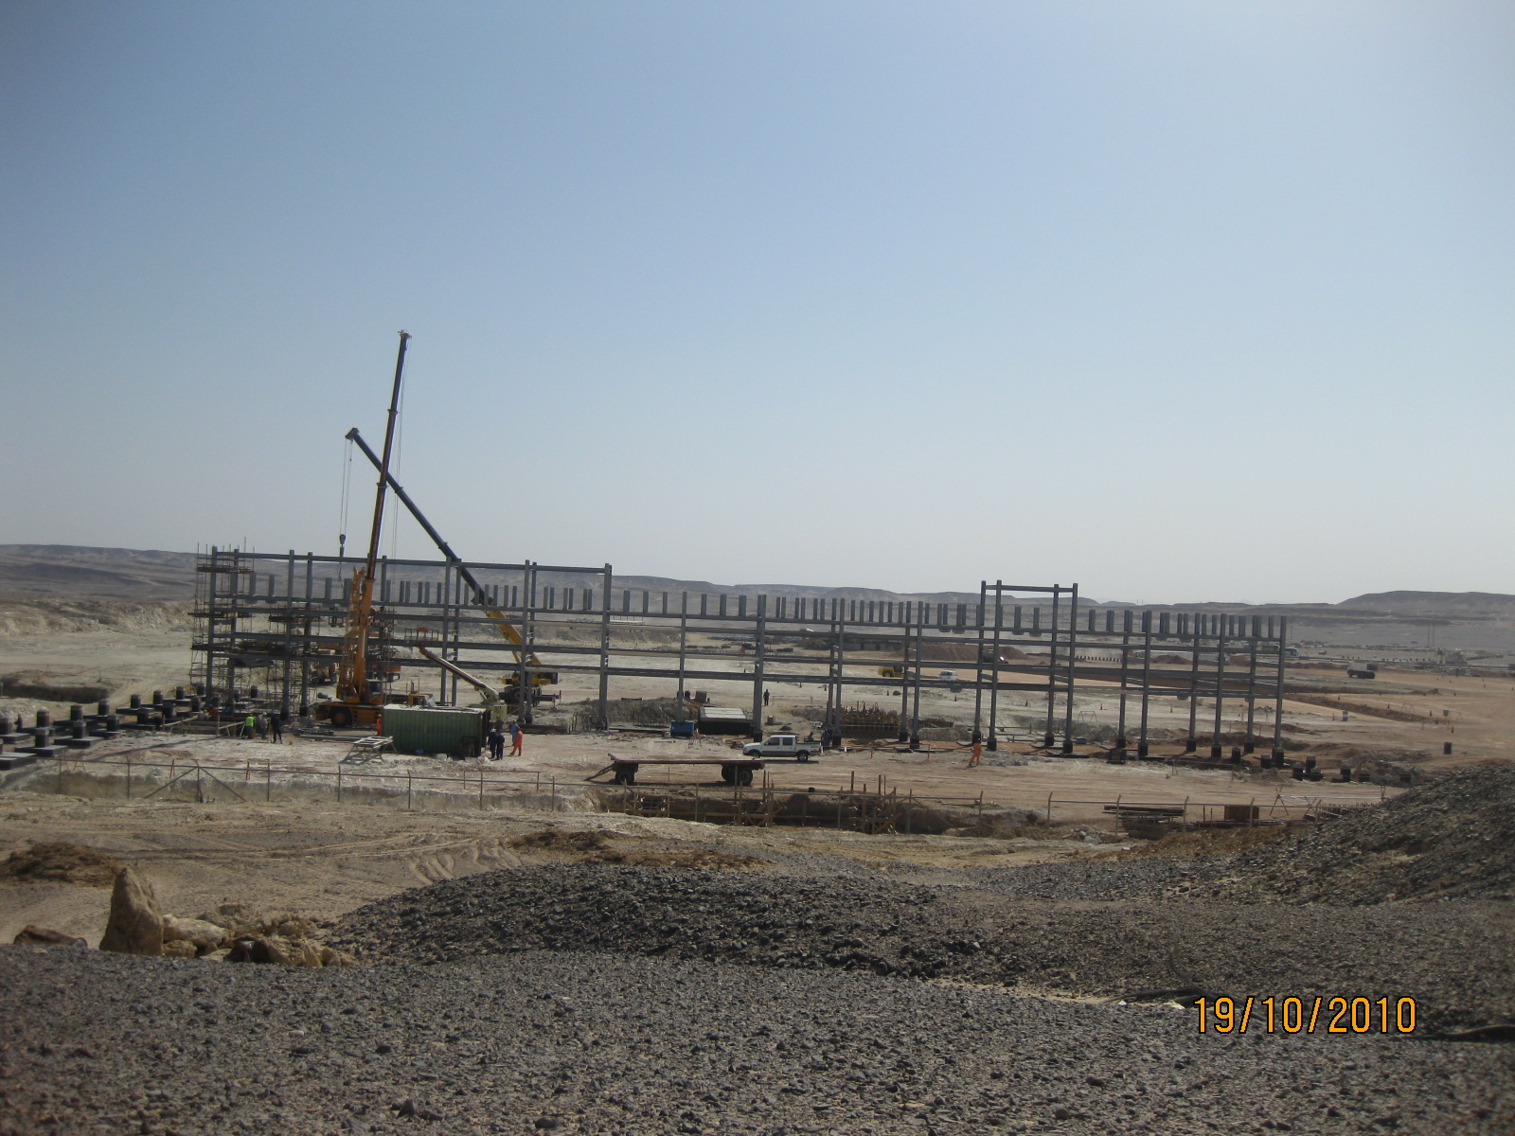
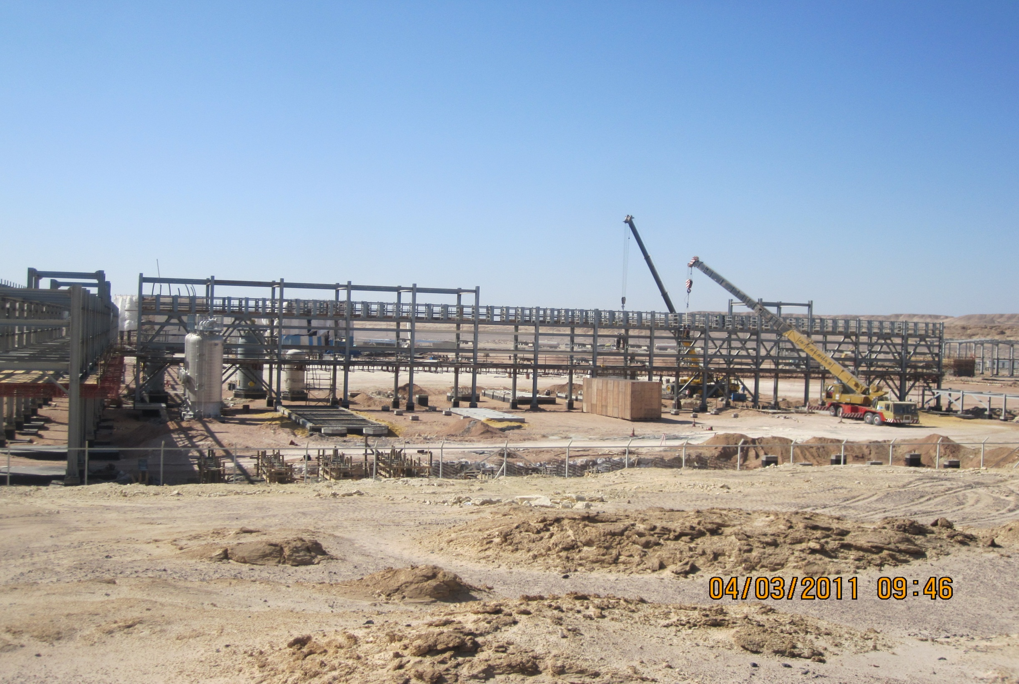
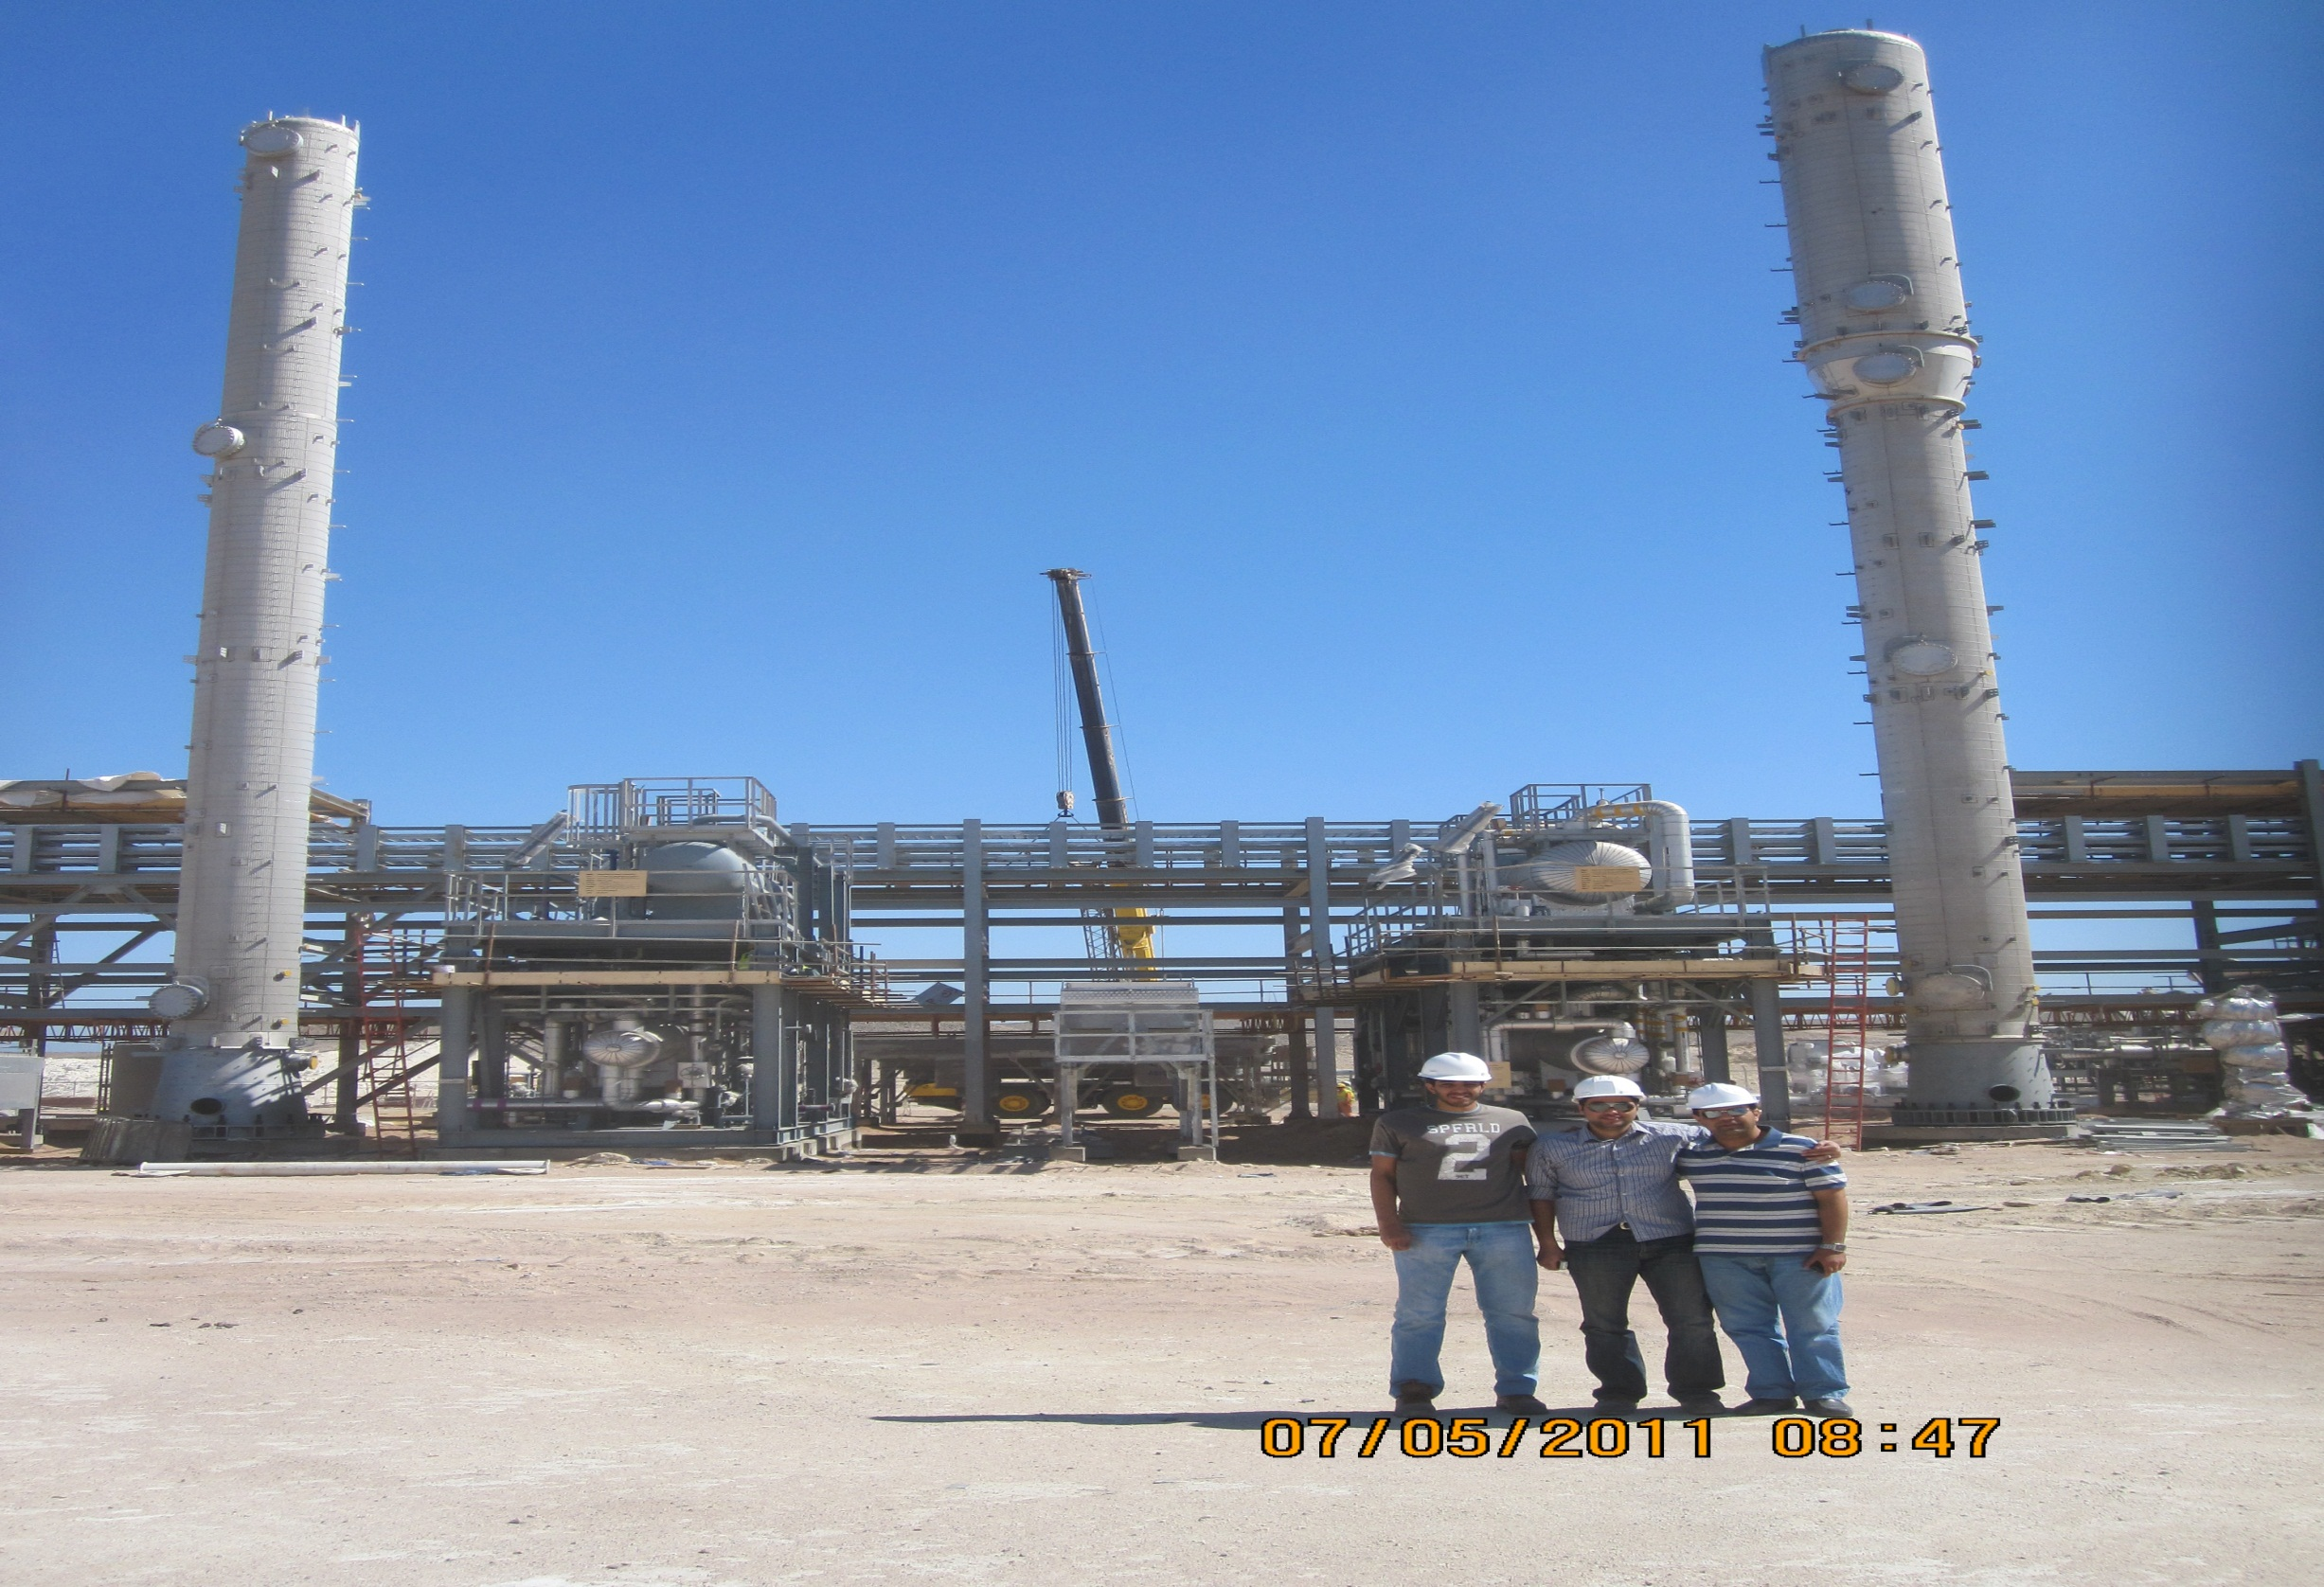
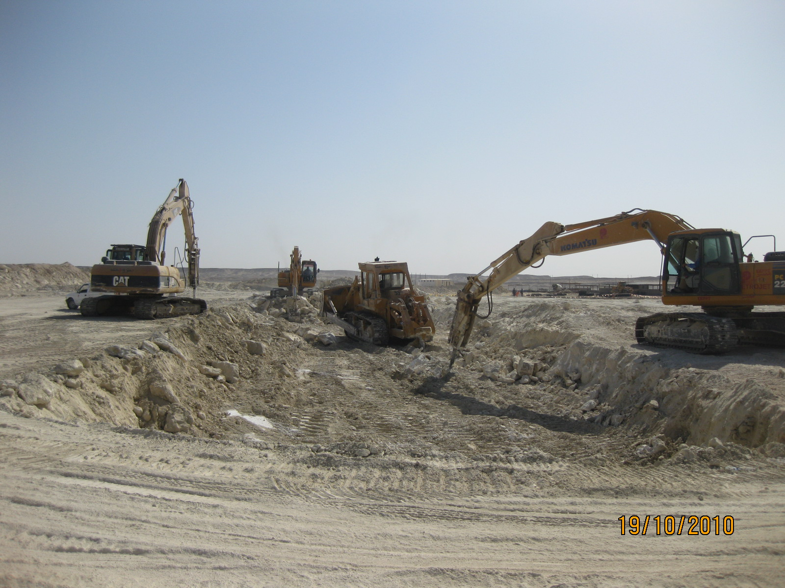
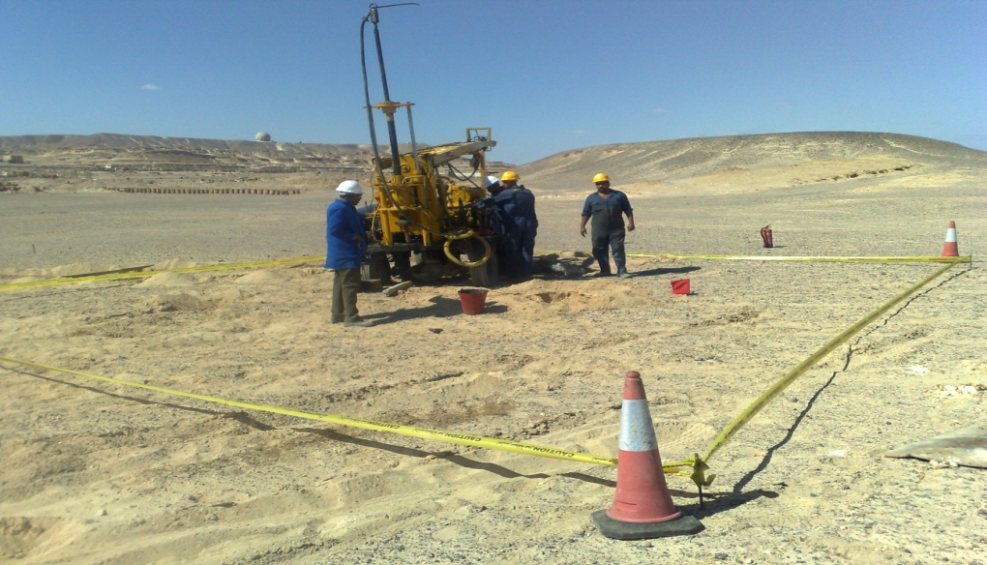
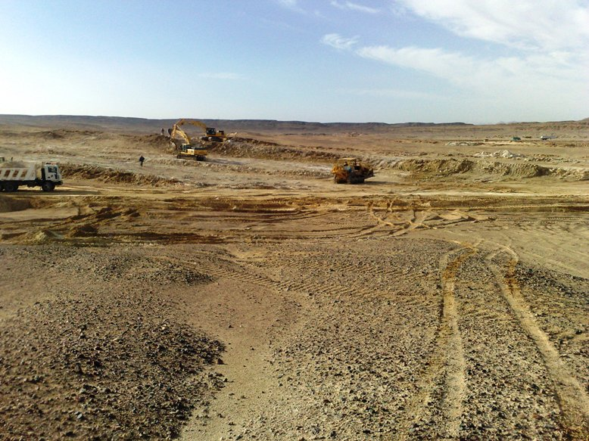
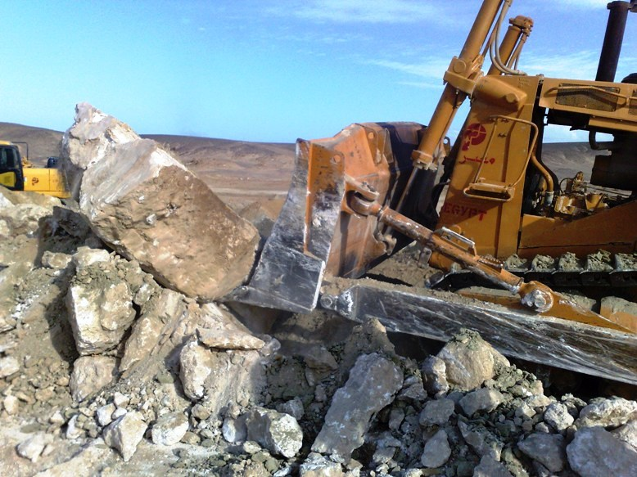
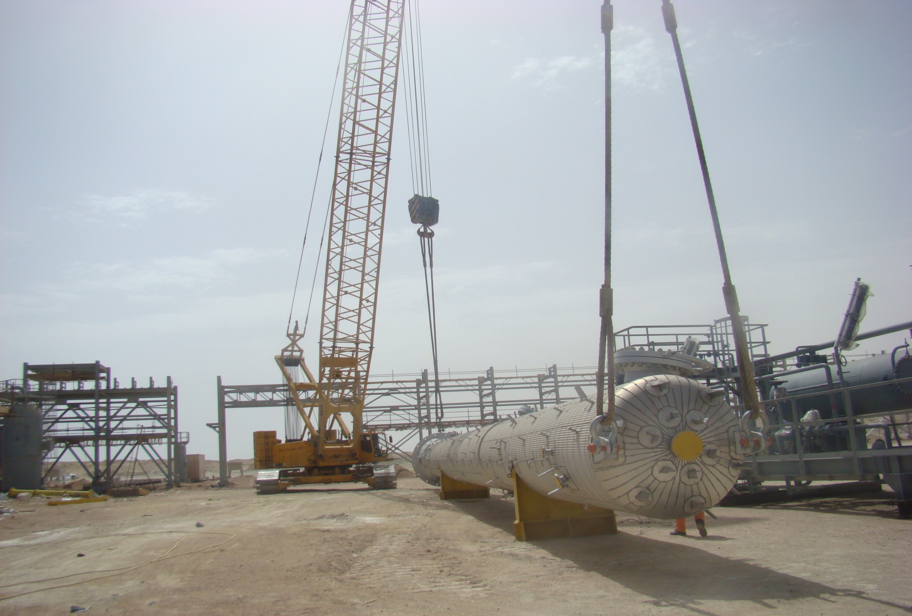
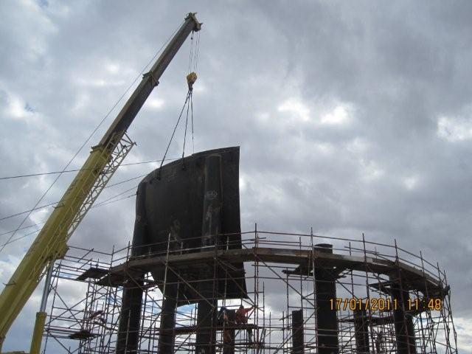
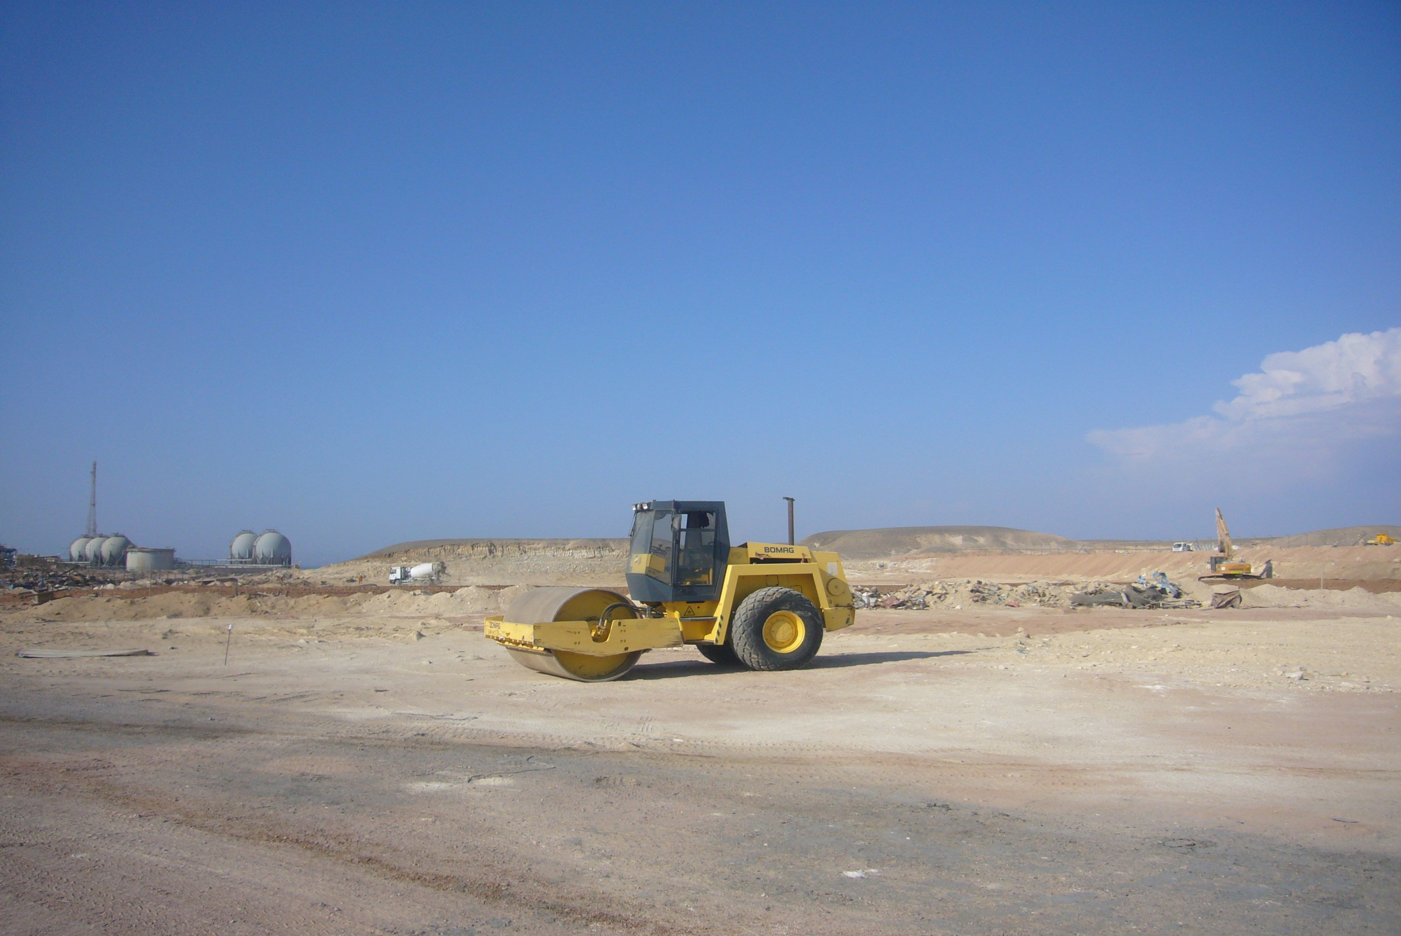
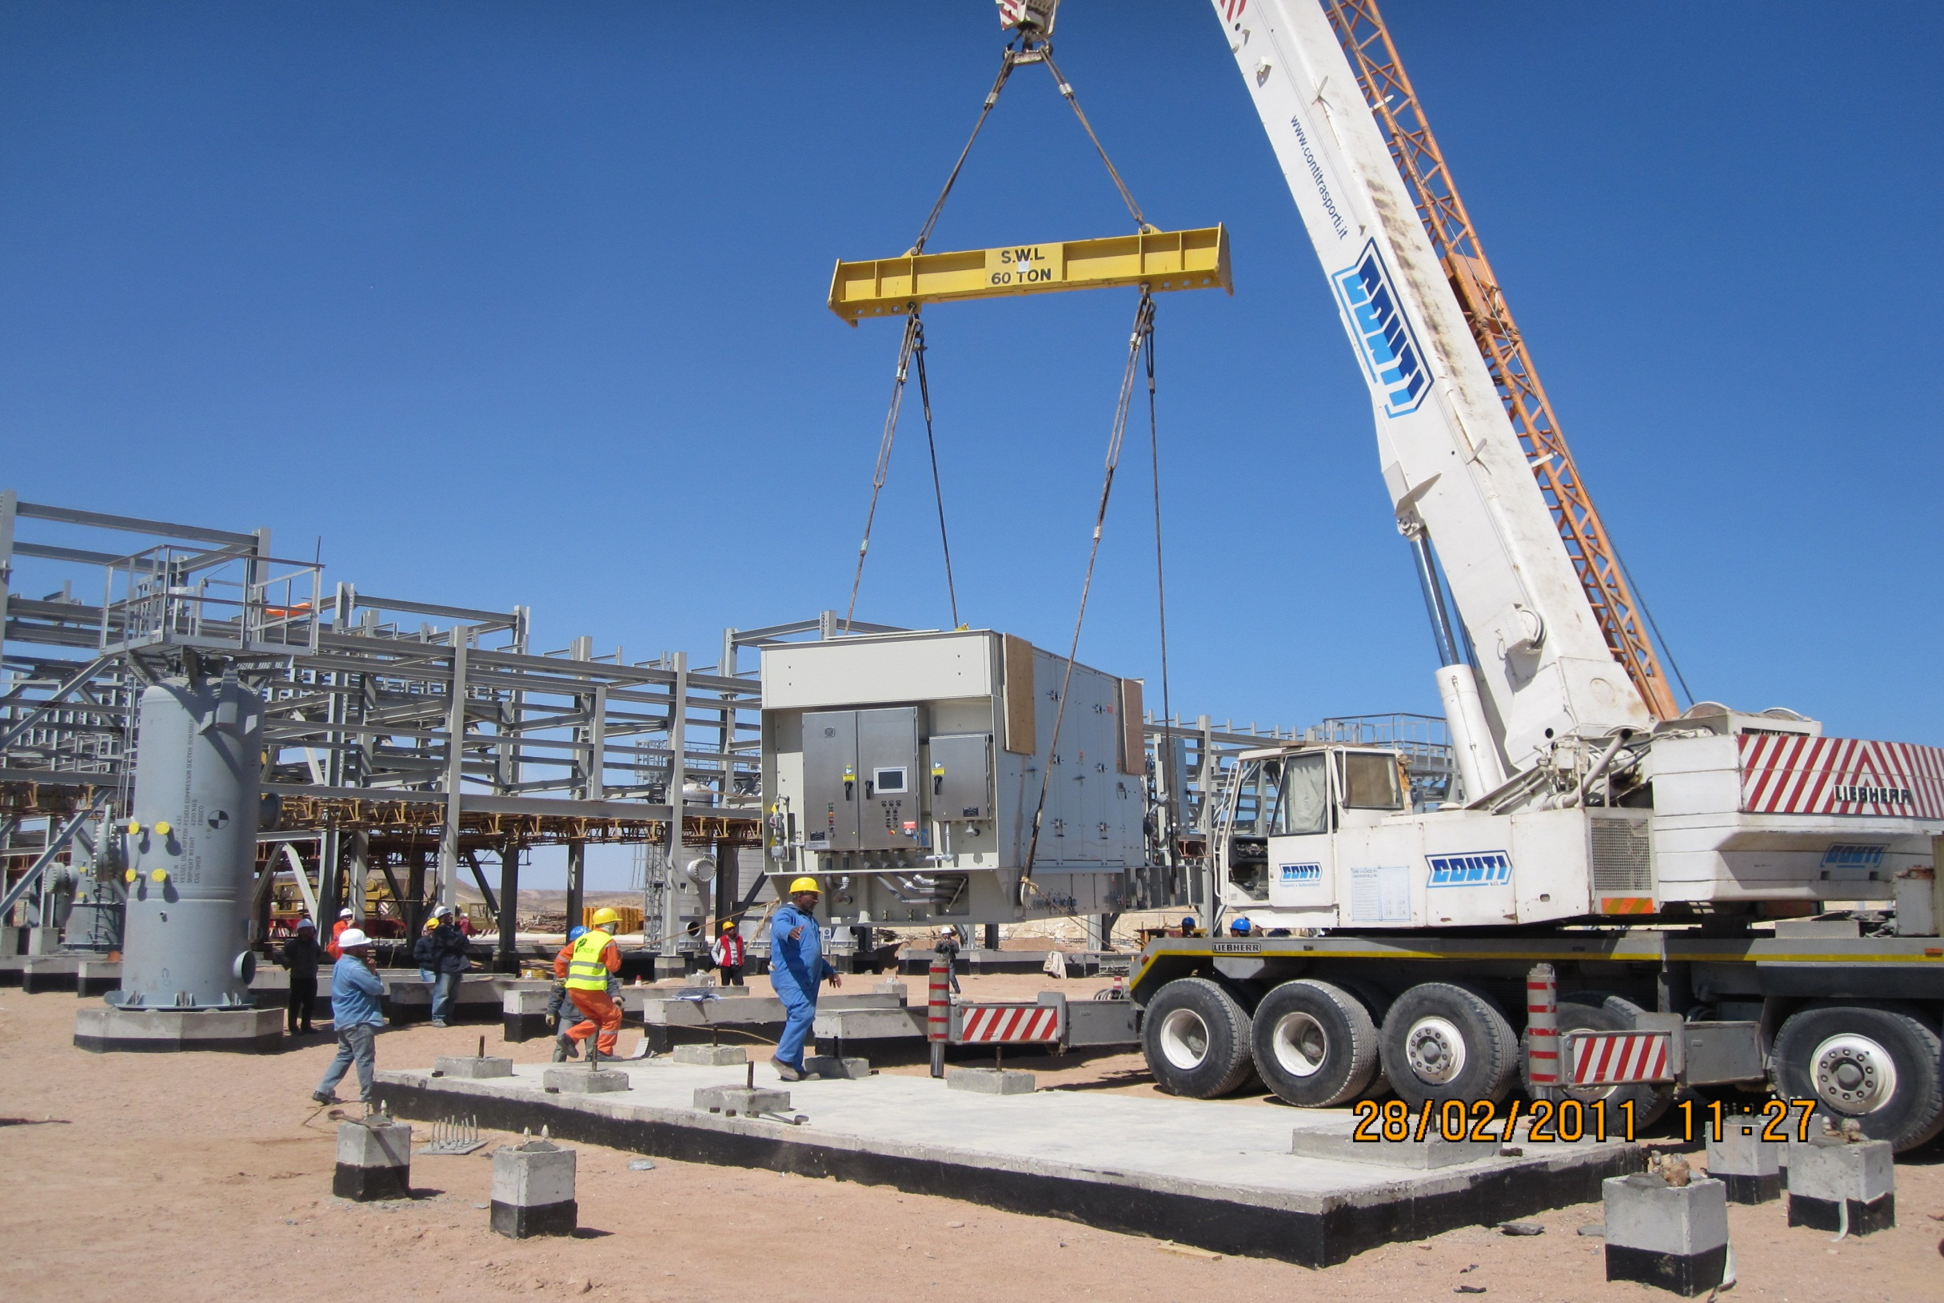
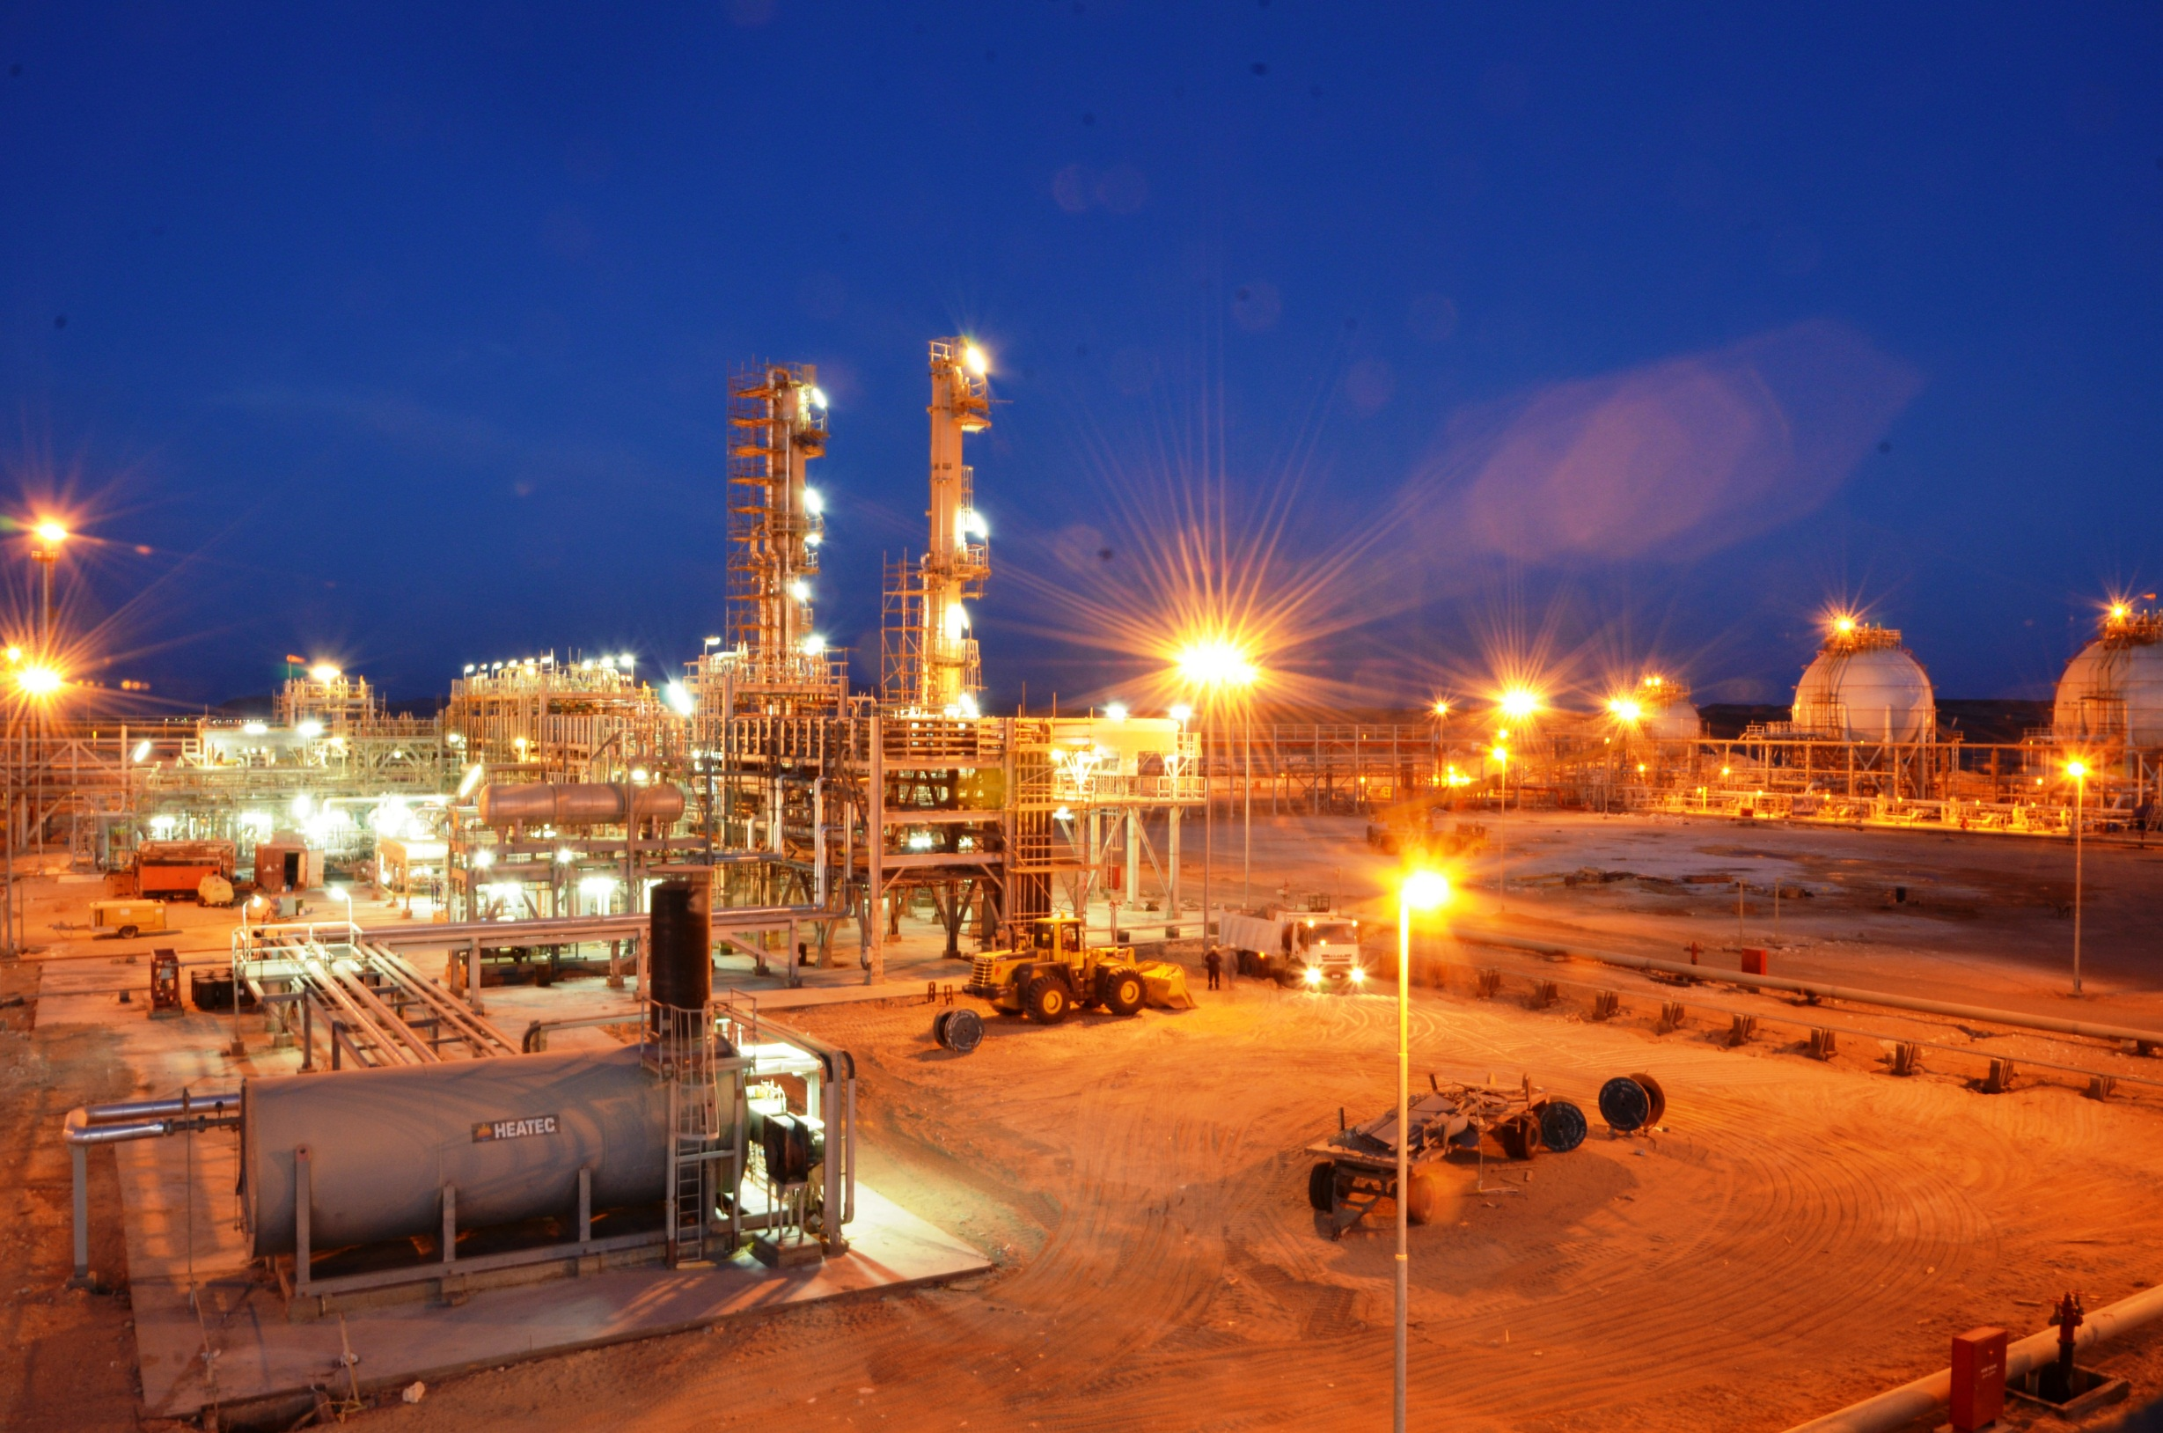
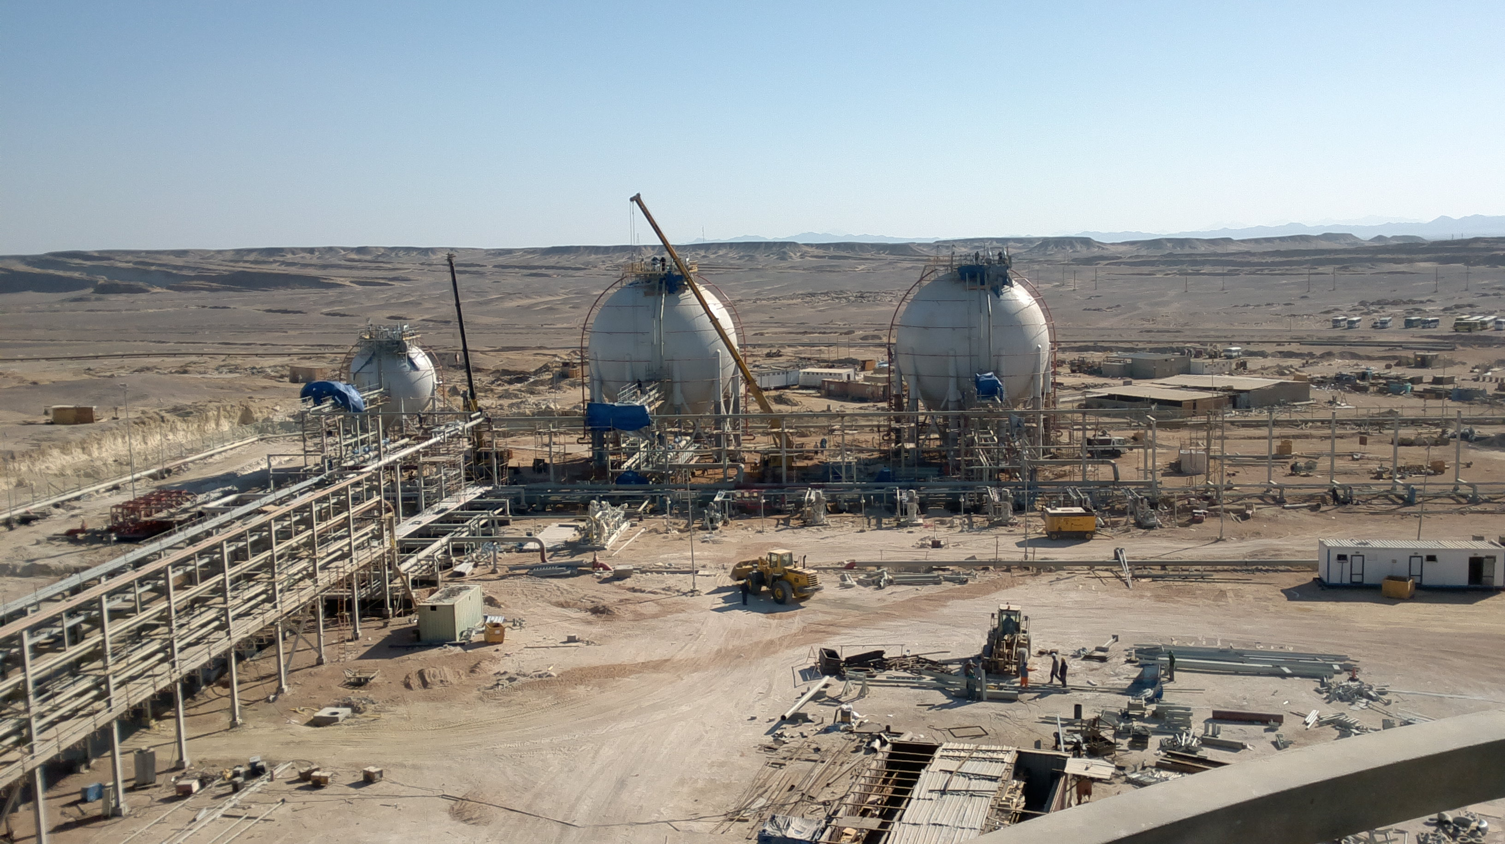
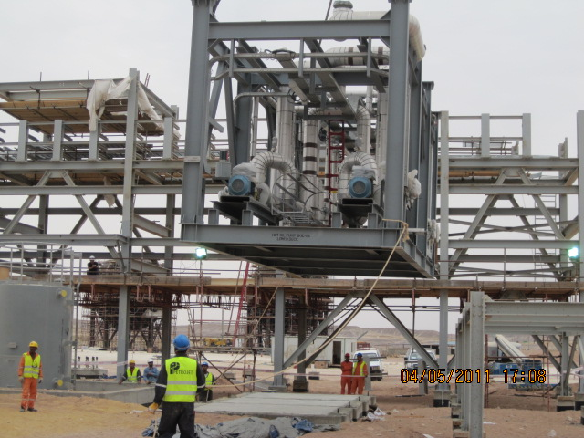
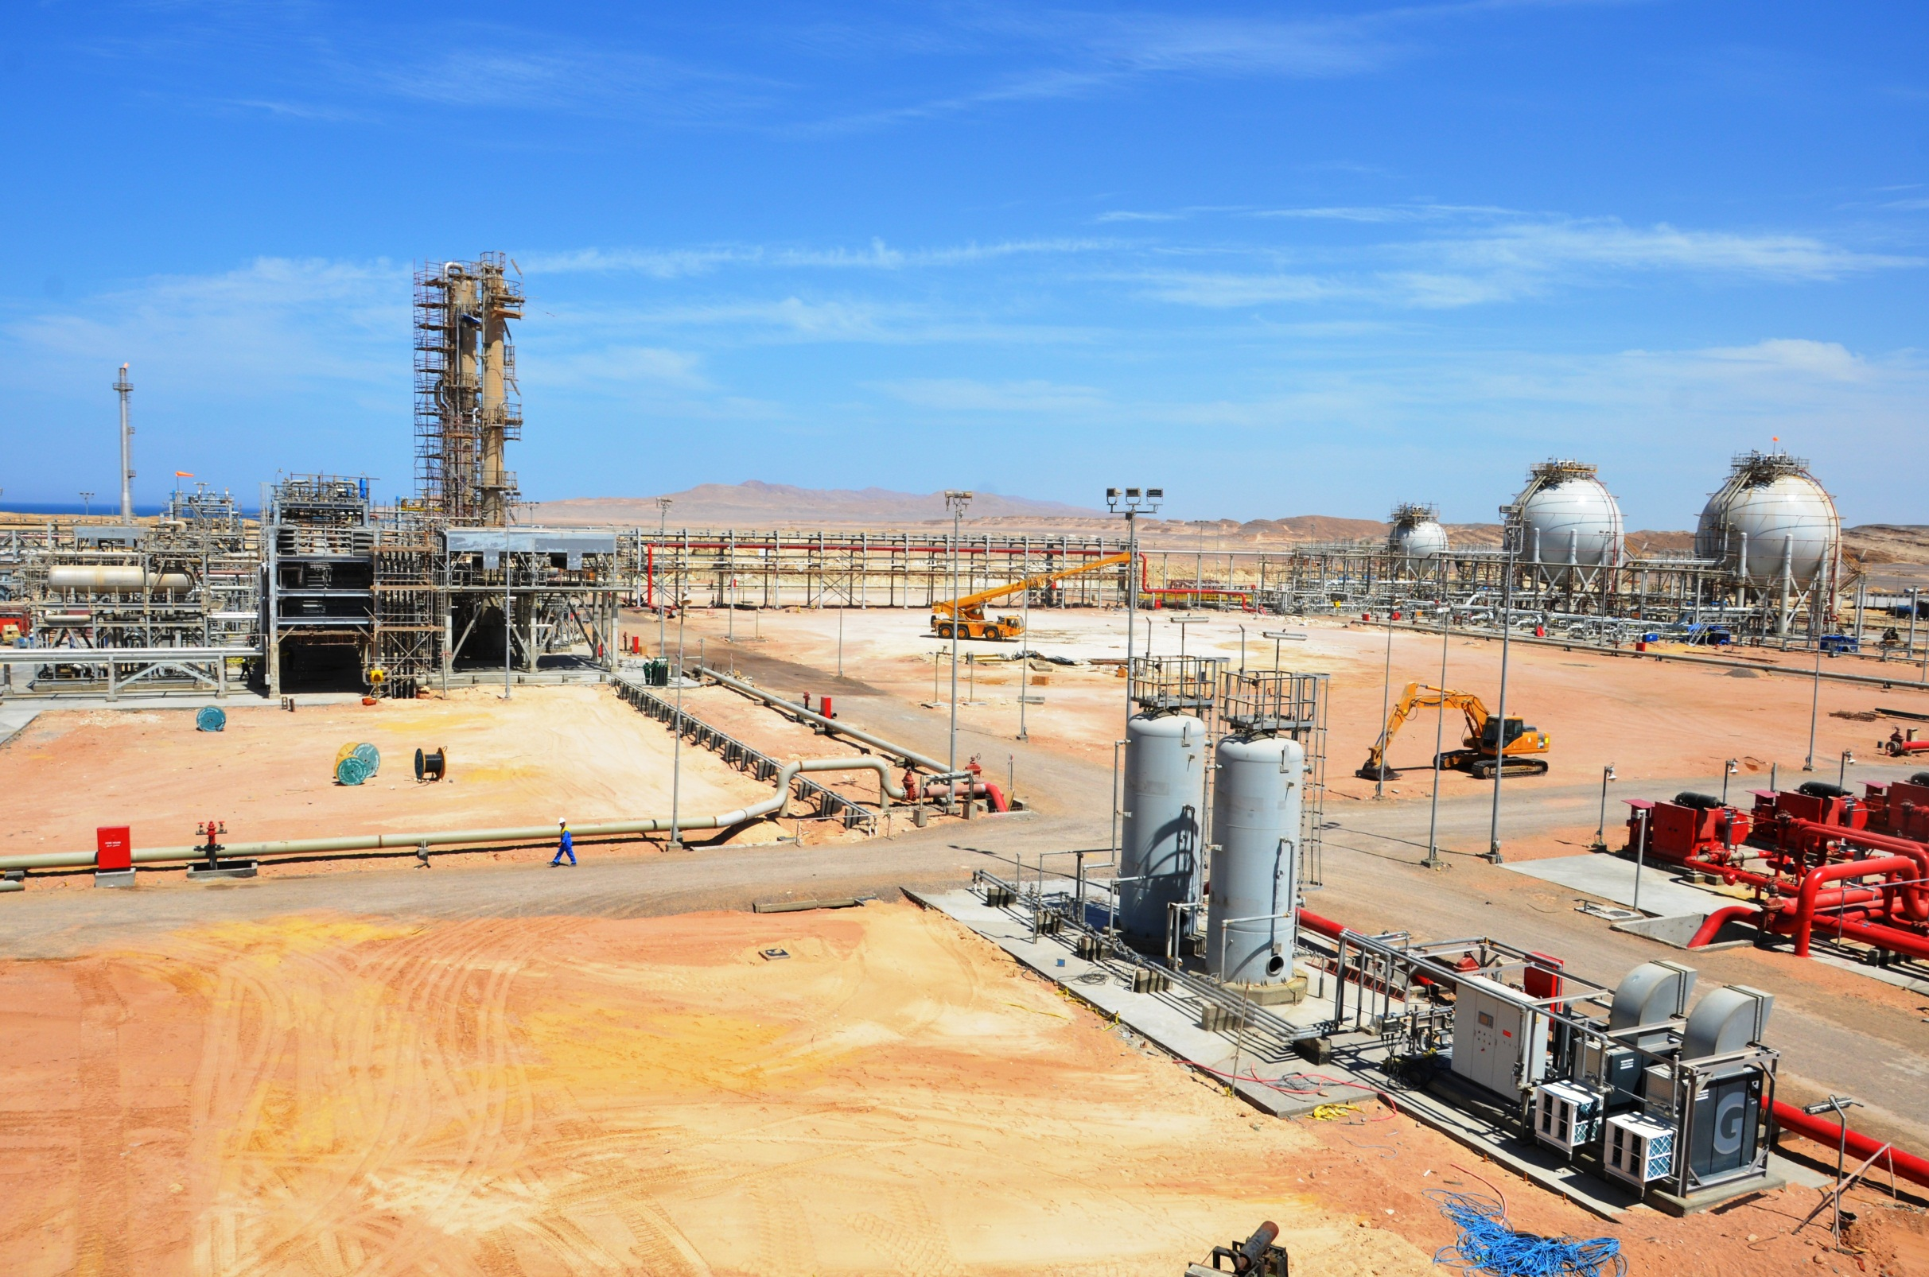
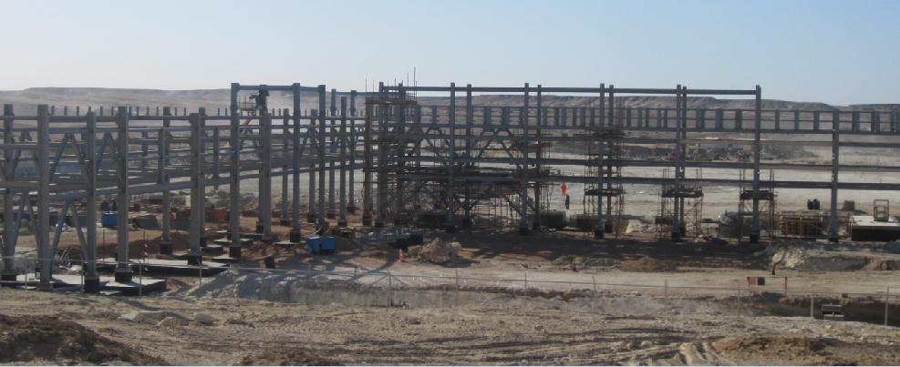
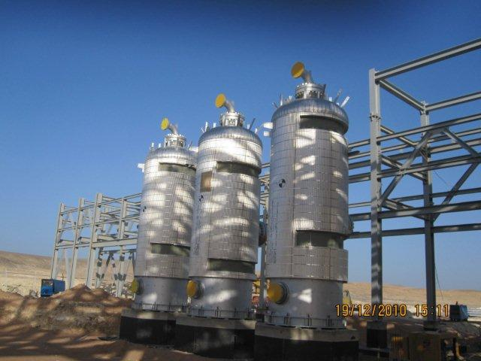
EBGDCO
DREAM
BECAME
FACT
EBGDCo Site Location
EGPC U-104

Slide 6
EBGDCo Vision, Mission & Strategies
Develop the employees capabilities and build the leadership motivation through training.
Reach the best performance in all dep. with a continuous monitoring and feedback to maximize the products.
Strategies
Mission
Vision
To be a strong competitor in the gas derivatives field
Achieve highest staff performance
Achieve business objectives by reducing costs and maximize product selling price.
Sustain value and create strong financial returns for our shareholders and employees.
Maximize propane and butane production to fit the international & local market specifications safely, reliably and profitably.
Maintain ZERO HSE records
Apply high measures of process safety matching with the international stander KPI’s and best practices.
Maintain plant equipment reliability and availability at highest level.

Slide 7
EBGDCo HSE Management System
QHSE Policy
HSE Management System Procedures
Measurement and Record Keeping
HSE Practices and Instructions

Slide 8
EBGDCo Positive Performance Indicator (PPI) (2012-2015)

Slide 9
Construction, Commissioning, startup & Operations Phases Performance Summary
Zero Fatality
Zero RIFR
1.2 VAFR
3 minor Fires (construction)
Zero DAFWFR
1850 PPI
EBGDCo team achieved a record of more than 6 Million working man hours without injuries since construction phase of the Plant .

Slide 10
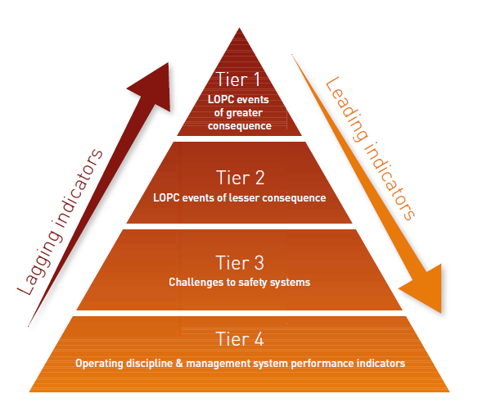
Process Safety KPIs (2012-2015)
Currently we are working on developing higher level of process safety KPIs concept to ensure deeper monitoring and measurement of Process Safety Performance based
on API RP 754
Increasing trend of PPI
Represents increasing
leading indicators forcing
PSI towards tier 3 & 4
Tier 1
(LOPC with high consequences)
Zero
Zero
7 (LOPC with minor consequences)
33 (Process upsets mostly resulted in process unit trip / shutdown with minor losses in production for average period of 1 hour per event)
Tier 2
(LOPC with lower consequences)
Tier 3
(Near miss & HSE challenges or other LOPC minor consequences)

Slide 11
EBGDCO Facility Situation
EBGDCO plant designed to process associated gas quantity up to 165 MMSCFD with propane content from 2.5% - 4.4%
Currently the feed gas quantity and quality for EBGDCO is 150-155 MMSCFD and propane content 2.3-2.6% respectively
EBGDCO plant still have room space in the plant capacity to handle either more gas quantity or more propane content

Slide 12
Avg. Gas throughput vs. Propane content in Feed Gas
(2012-2015)

Slide 13
Avg. Gas Throughput Vs. Propane Content For Year 2015

Slide 14
EBGDCO Plant Productivity
(2012-2015)

Slide 15
Feed gas Improvement cycle
150 MMSCFD
C3 % 2.26
180 Ton/D
120 MMSCFD
C3 % 2.3
150 Ton/D
90 MMSCFD
C3 % 2.49
110 Ton/D
Start up
70 MMSCFD
C3 % 2.48
80 Ton/D
20 MMSCFD
C3 % 2.5
30 Ton/D
In 2013 EBGDCO success to increase the feed gas by utilize the fuel gas in Gupco plant
Prior to our Plant start up EBGDCO Management team success to divert gas lift at SUCO plant
In 2011 all the available gas down stream Gupco plant was 20 MMSCFD
Currently we reached the max gas flow rate which are 150 MMSCFD but C3% still at min design level
In 2014 due to several co-operation between EBGDCO and Ministry of petroleum reflected on increase the qty of the gas from Amal field

Slide 16
Propane Marketing & Loading
(2012-2015)
EBGDCO take the responsibility of marketing the propane
September 2014
34 tankers TRAFIGURA
26 tankers LITASCO
Total No. of tankers = 69 tankers
9 Spot cargoes
February 2015
October 2012
December 2015
Total propane loading quantity = 171,513 Tons

Slide 17
Total Propane Revenue According To Propane Selling Price
(2012- 2015)
sontrach-218 $
sontrach-125 $
sontrach-115 $
Total propane revenue = $71MM

Slide 18
Crisis Management
Short term actions
Long term actions
Increase Propane revenue by ($6MM/year) as a result of decreasing of selling propane discount.
Negotiate with the propane buyer for a pre-payment amount of $5MM.
Reduced EBGDCO operating expenses by (30%)
Reschedule $10 MM of from loans installments 2015.
Shareholders Inject $10 MM (Project cost).
Communicate with international company specialist in the propane price expectations to get propane price forecast.
Negotiate with EGPC to enhance C3% in feed gas to be at least 2.5%.
Maximize our feed gas (Badri gases).
Enhance propane selling discount .
Utilize all the available gas (Suco, GPC) at the area by create new projects .
Reschedule loans installments 2016.

Slide 19
Project Cost (125 $ MM)
$MM
Shareholders contribution loan
Project over run
Equity
CIB Loan

Slide 20
Cash In (2012-2015)
Total Cash In $79MM

Slide 21
Cash Out Summary (2012-2015)
Total Cash out $100MM

Slide 22
Cash in / Cash out ( 2012-2015 )
61 MM$ expenses
23 MM$ Bank Installment
16 Dues
79 MM$ cash in
61 MM$
79 MM$
Zero
-5 MM$
-21 MM$

Slide 23
Propane Average Prices Per/Ton ( 2012-2015)
$/Ton
67 %

Slide 24
Propane Loaded vs. Propane Revenue
( 2012-2015)

Slide 25
Current EBGDCO Cash flow
(Nov 2015- Feb 2016)

Slide 26
Thanks

